Slide 1
Further Tracking Down Unmapped Reads
Nov 10, 2021

Slide 2
Overview
Unmapped sequences consist of different populations:
insertless and short amplicons
misligated DOs
>2 sequencing errors
Because the short amplicons vary a great deal in size, we interpreted their origin as variable digestion during the nuclease step.
By examining the unmapped sequences from several conditions that decrease mapping rate, we can conclude:
Unmapped sequences are not random after all.
Generating the insertless amplicon is a dynamic process.
Short inserts are independent of DO input but misligations are not.
Short inserts are not templated by ligated DOs.
We can apply these results to the single cell assay by:
Limiting the DO concentration
Limiting the number of PCR cycles
Limiting the PCR primer/dNTP concentrations
Increasing the efficiency of residual DO fragment removal
Replace DOs that have homologies to primer landing sites

Slide 3
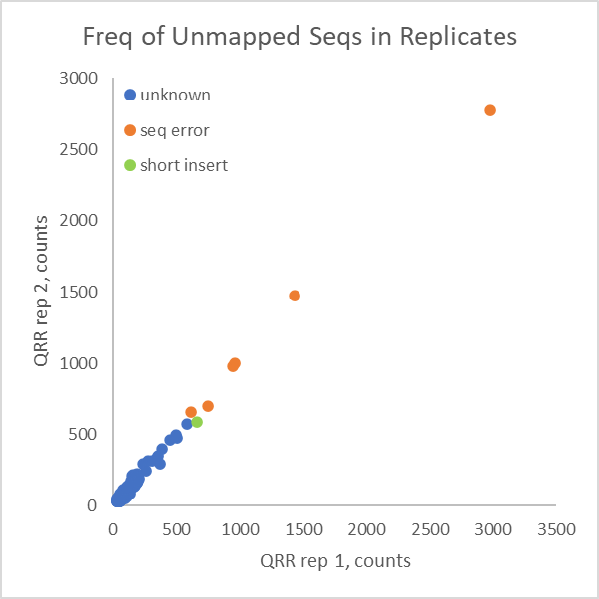
If Structures are Important, then Unmapped Should Be Repeatable
High input, high mapping rate samples done with whole transcriptome. Low levels of unmapped reads are dominated by sequencing errors of abundant transcripts (orange). Green indicates a case of a very short insert, and blue indicates sequences not yet characterized.
Surprisingly, there is an excellent correlation in reads between replicate assays. This suggests that unmapped reads arise from an underlying systematic cause rather than pure random digestion variability. This supports the idea that there may be certain DOs that contribute to unmapped that should be redesigned.

Slide 4
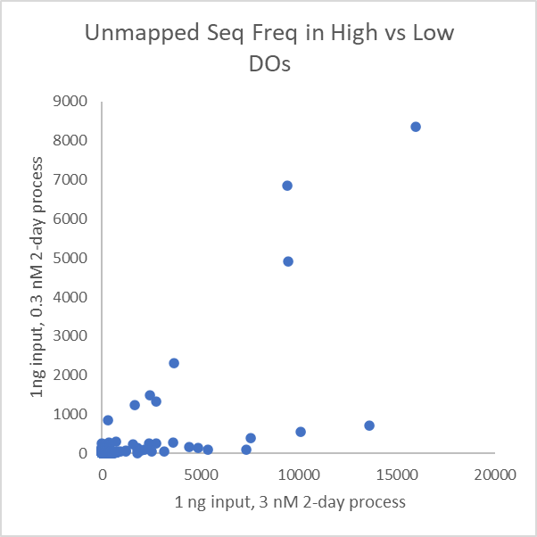
Unmapped Reads vs DO Concentration
One instance that results in high unmapped rates is high DO concentration in the 2-day assay.
Unmapped sequences fall into 2 distinct classes: one that is limited to the high DO condition (green arrow) and one that is common to both conditions, so independent of DO level (red arrow).
The DO-dependent group consists entirely of misligation products.
The DO-independent group consists entirely of short inserts.

Slide 5
Shorter Inserts at Later Cycle Numbers
Seqs that are more frequent at 16 cycles
Counts at 10 cycles | Counts at 16 cycles | Insert
2142 | 5140 | GTTC-PLS*
1632 | 4231 | TC-PLS
551 | 1767 | CTCTTG-PLS
516 | 1553 | G-PLS
267 | 1116 | TATTTT-PLS
Seqs that are rarer at 16 cycles
Counts at 10 cycles | Counts at 16 cycles | Insert
2718 | 501 | TTGTTGCTATCAGT-PLS
1535 | 132 | CAGGAC-PLS
1392 | 34 | TCTGCTTTGATGTGTC-PLS
1042 | 34 | TTGCAAGGA-PLS
790 | 20 | TGAAAGTTAA-PLS
*PLS = primer landing site, the end of the insert
Insert shortening is progressive.

Slide 6
Shortened Inserts Across Tissues
The great majority of unmapped reads for 100 ng inputs of high-quality RNA is due to sequencing errors (not shown). Frequent unmapped reads due to sequencing errors correlate with tissue-specific expression.
In contrast, the frequency of short inserts is consistent across 10 tissues. This is shown here, where the UDO primer landing site is shown in red text.
This consistency suggests that the short insert product is independent of RNA target expression level.
Note the discontinuity in frequency at a given position, where there are no examples of short sequences starting at positions 20 to 30.

Slide 7
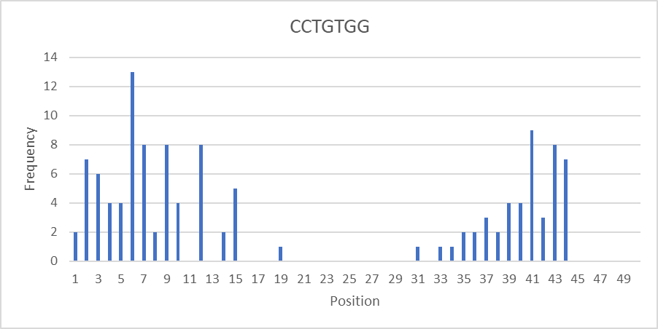
Frequency of Short Inserts by Position in Target
The short insert is not found spanning the ligation point. This suggests that:
the ligated product is protected somehow from use as a template for insert shortening, or
the template for shortening is the free DOs rather than the ligated product.

Slide 8
Short Insert Templates
Where the insert is the longest, the ligation product can be determined from the DDO/UDO fusion.
Of the sequences examined, most are the product of misligation. Note also the frequent simple repeats.

Slide 9
TempO-Seq Biochemical Steps
1) Contact sample with probe pair
Schematic for one RNA target is shown.
Each target is exposed to a ~1000-fold excess of detector oligos (DOs).
Each test starts with 3 fmol of DOs per target. After digestion and ligation, there should be ~3 amol of DOs per target as amplifiable template.
Each amplification starts with 20 pmol of each primer. In the WT assay, there would be ~60 fmol of amplifiable templates. That means a ~300-fold greater number of primers to templates, sufficient to efficiently amplify all templates from the first cycle for maximum sensitivity and repeatability.
RNA target
+
probe pair with multiple sequences
2) Probes bind RNA target
+
excess probes
3) Add 3’ Exonuclease
protected probes
digested probes
and partially digested probes
due to secondary structures
4) Ligate Probe Pairs
ligated probes
5) Amplify
5’ 3’
oligo sequence orientation
amplification

Slide 10
Potential Templates
5’ Forward…CTACACGACGCTCTTCCGATCT 3’
DDO: 5’CTACACGACGCTCTTCCGATCTCTTGCACTAGGCCACTTCCTAGCCT
primer landing site
downstream target seq
primer landing site
upstream anchor seq
5’PHOS-GCAGGCTGCCTATGGATCTCCTGTTCCTGTGGTCGTAGCATCAGCTACTTGCCACTCAGGGCCC 3’:UDO
upstream target seq
3’GGACACCAGCATCGTAGTCGAT… Reverse 5’
Residual partially digested detector oligos may contain primer landing sites, but only if they survive the exo step. This would require 2 things:
1) some cross-hybridization between different detector oligos or some secondary structure within detector oligos that is stable during the exo digestion
2) a protected sequence that can hybridize to at least the 3’ end of one or both primers.
The most common sequence found in unmapped reads is the fusion of the forward and reverse primers, which appears as 5’…GATCTCCTGT…3’. If this sequence is present in detector oligos and can persist into the amplification, the resulting amplicon would be smaller and therefore more efficiently accumulated.
The Whole Transcriptome detector oligos were screened for the sequences in blue and red, as well as their reverse complements and concatemers.

Slide 11
Detector Oligo Mispriming Sites
Of 22,537 detector oligo pairs (45,074 oligos), 5,107 oligos have at least 1 instance of GATCT, AGATC, CCTGT or ACAGG, sequences that could be primer landing sites.
Of these, there are 643 oligos that have at least 2 of these sequences that could support stem-loop structures. These would include GATCT…AGATC, AGATC…GATCT, CCTGT…ACAGG, and ACAGG…CCTGT.
There are 7 oligos that contain fusion sequences:
3 have GATCTCCTGT
2 have AGATCCCTGT
1 has ACAGGTCTAG
1 has GATCTGGACA
So there is opportunity for mispriming if these sequences can persist.

Slide 12
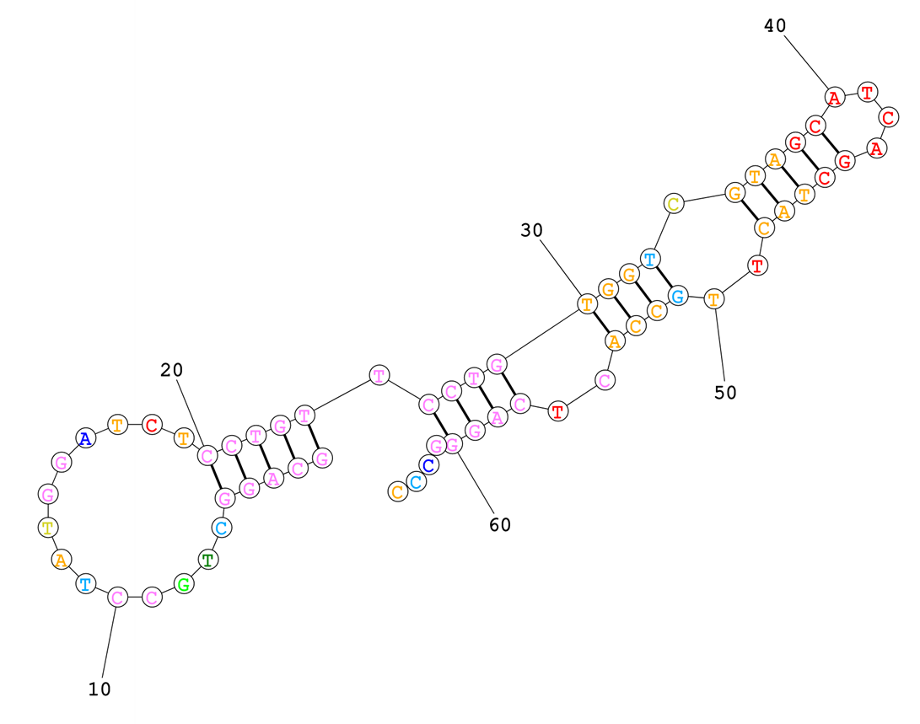
Detector Oligo Structures
Secondary structures are notoriously difficult to model successfully unless the structures are strong. Using a structure calculator available online from an academic specialist, structures were modeled for a few oligos with high frequencies of matching sequences.
In this case, there are 3 double stranded sections that are 3’ of the fusion sequence.
Even if the structure nearest the 3’ end breathes at 37C, the terminal stem loop has a >99% probability.
GATCTCCTGT
5’
3’

Slide 13
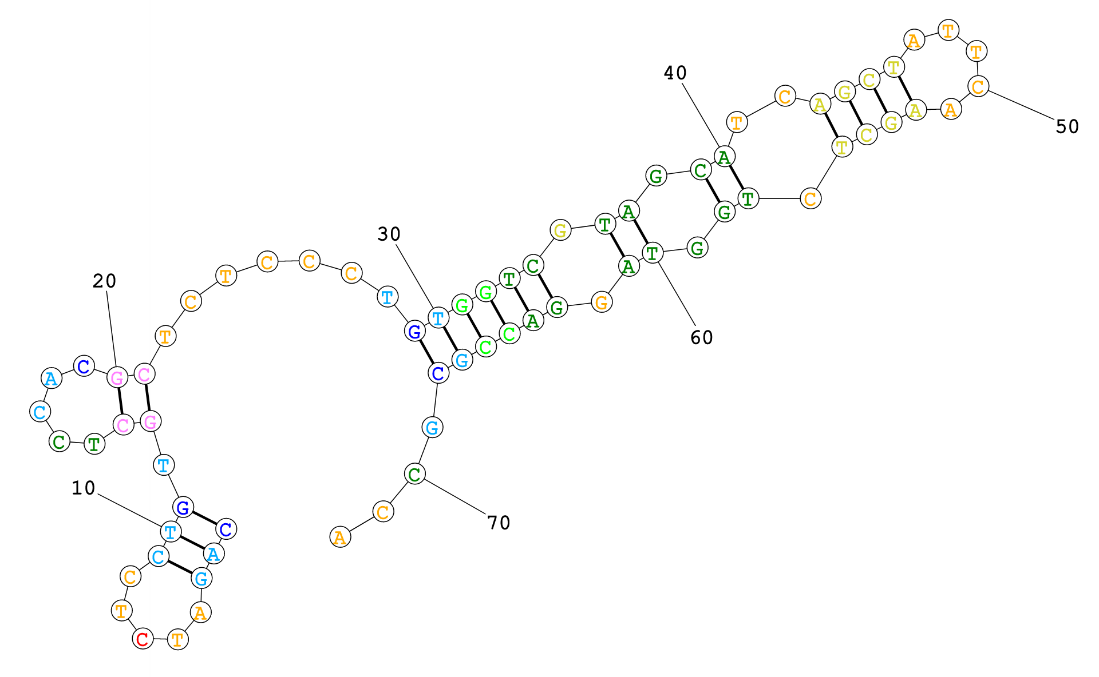
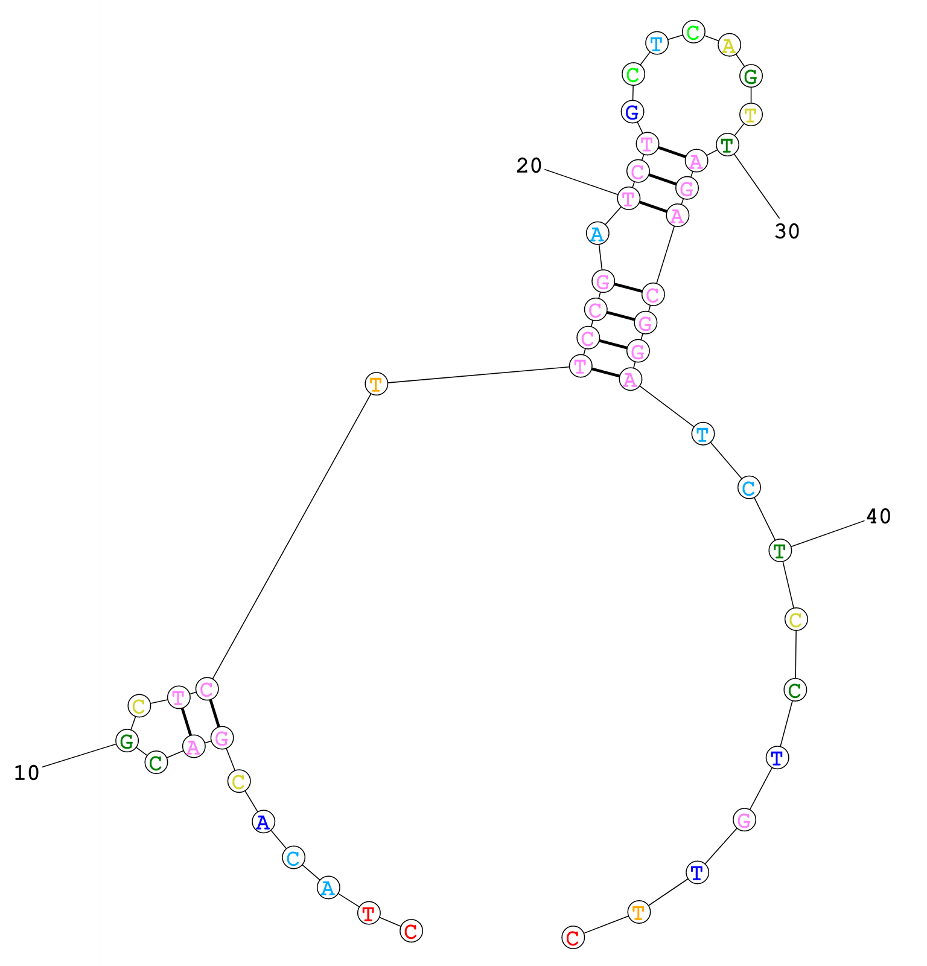
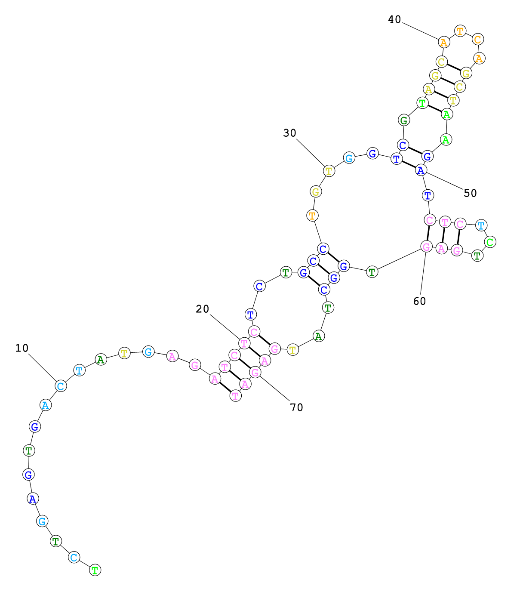
More Structures
GATCT
GATCTCCTGT
GATCT
Different structures are calculated for different oligos. However, there seems to be support for the general idea that structures can protect parts of detector oligos that contain sequences homologous to primer landing sites.

Slide 14
Summary
Unmapped sequences are not random, but are highly repeatable between technical replicates.
Unmapped reads are a collection of sequences that result from sequencing errors, misligation, and mispriming resulting in short inserts. The abundance of each category varies with target input, DO input, and cycle number.
Minimizing unmapped reads can be controlled for some mechanisms:
Misligation can be controlled by limiting DO concentration.
Progressive shortening of insert size can be controlled by limiting cycle number.
The mechanism for insert shortening is independent of RNA target level and ligated product, so is likely a side reaction in the PCR with residual DO fragments. This may be controllable by:
Removing homologies to the PCR primer 3’ ends. A direct test of DO subsets with different degrees of primer homology is being sequenced soon.
Reducing PCR primer/dNTP concentrations

